Slide 1

Java™ How to Program, 9/e
© Copyright 1992-2012 by Pearson Education, Inc. All Rights Reserved.

Slide 2
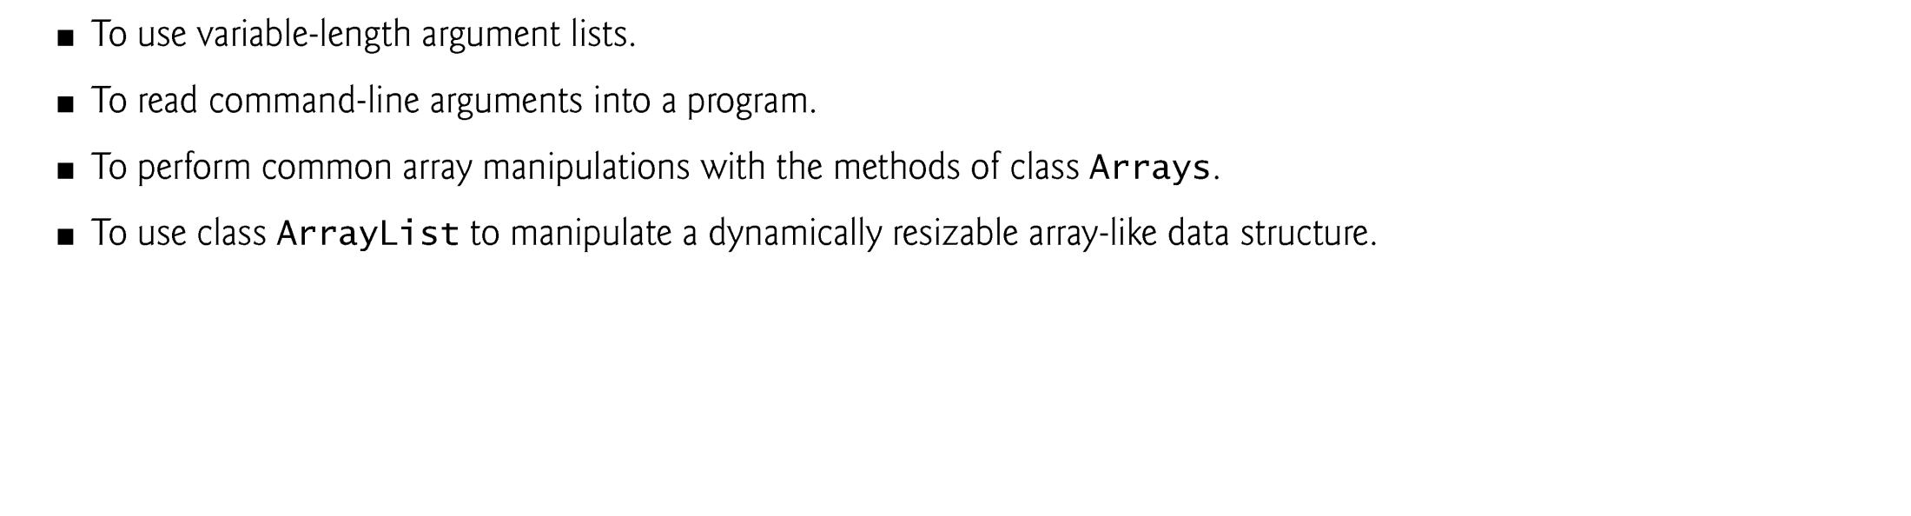

Slide 3
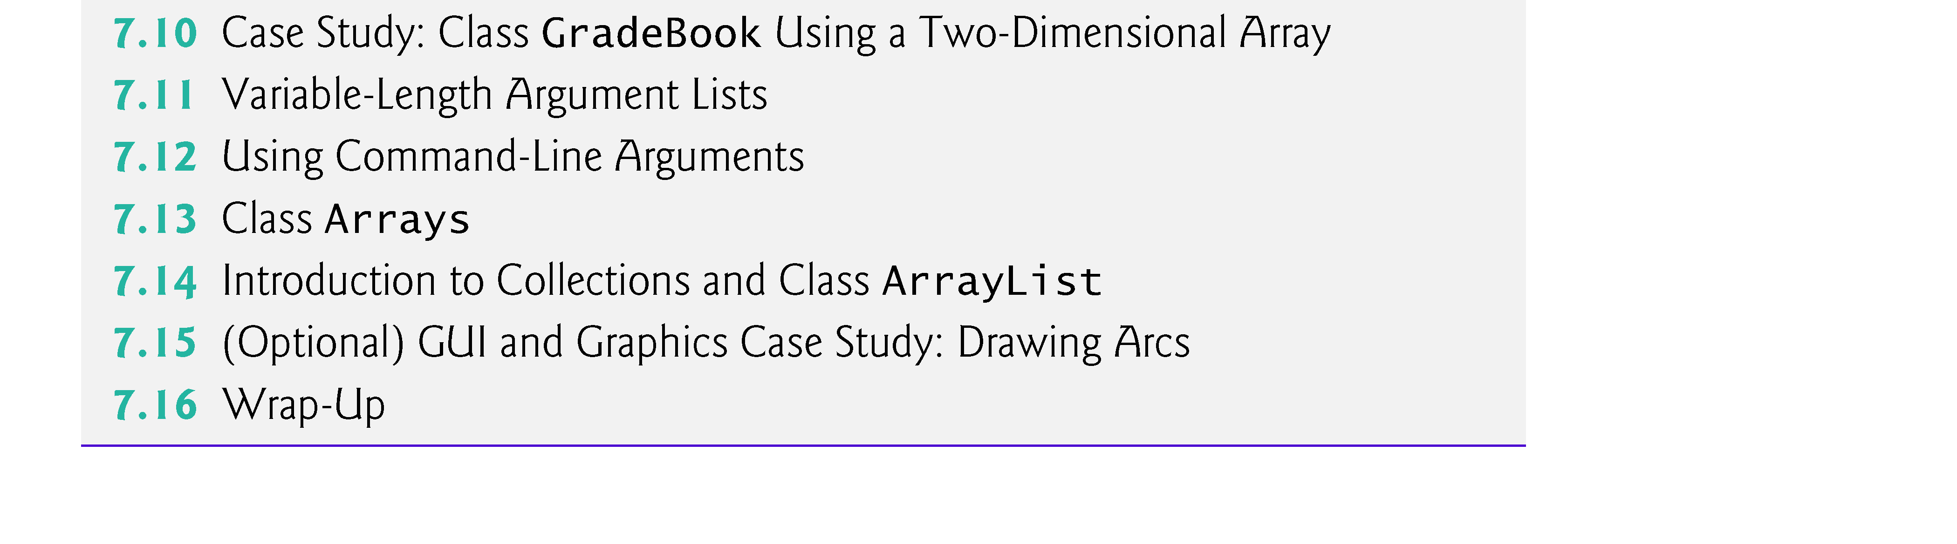
© Copyright 1992-2012 by Pearson Education, Inc. All Rights Reserved.

Slide 4

Arrays class
  Provides static methods for common array manipulations.
Methods include
  sort for sorting an array (ascending order by default)
  binarySearch for searching a sorted array
  equals for comparing arrays
  fill for placing values into an array.
Methods are overloaded for primitive-type arrays and for arrays of objects.
System class static arraycopy method
  Copies contents of one array into another.
© Copyright 1992-2012 by Pearson Education, Inc. All Rights Reserved.

Slide 5
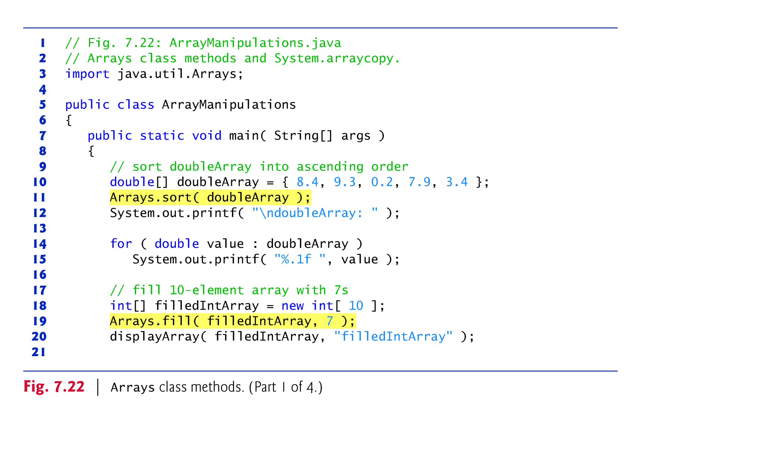

Slide 6
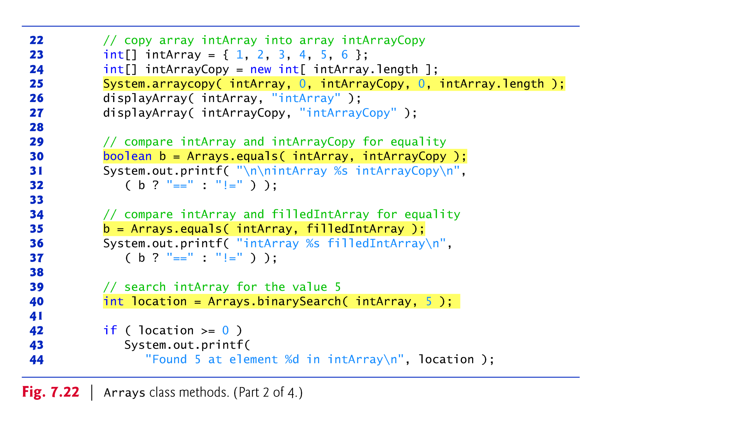

Slide 7
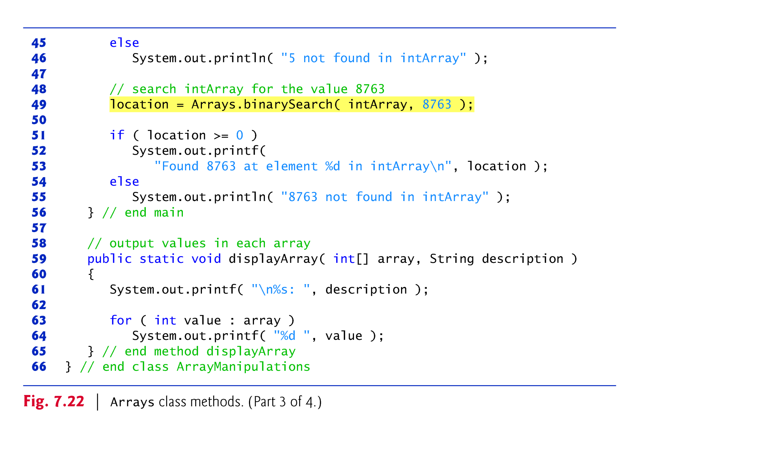

Slide 8
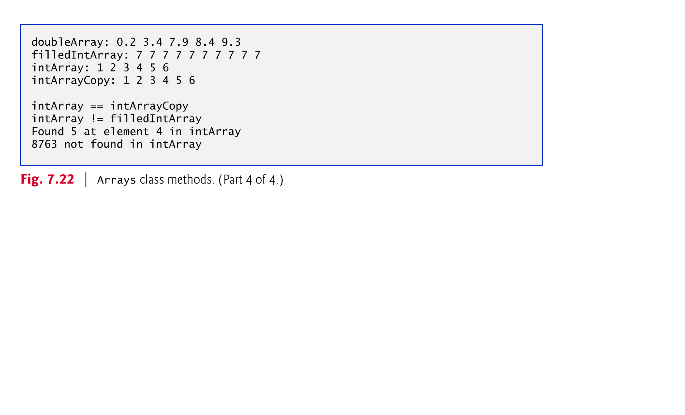

Slide 9
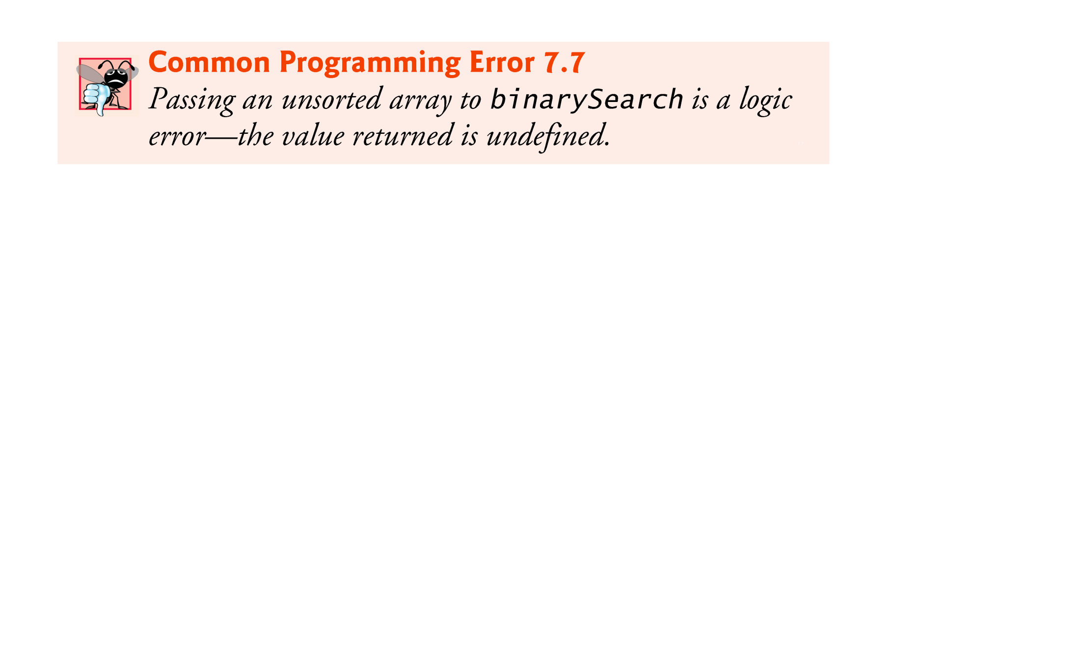
© Copyright 1992-2012 by Pearson Education, Inc. All Rights Reserved.

Slide 10

Variable-length argument lists
  Can be used to create methods that receive an unspecified number of arguments.
  Parameter type followed by an ellipsis (...) indicates that the method receives a variable num-ber of arguments of that particular type.
  The ellipsis can occur only once at the end of a parameter list.
© Copyright 1992-2012 by Pearson Education, Inc. All Rights Reserved.

Slide 11
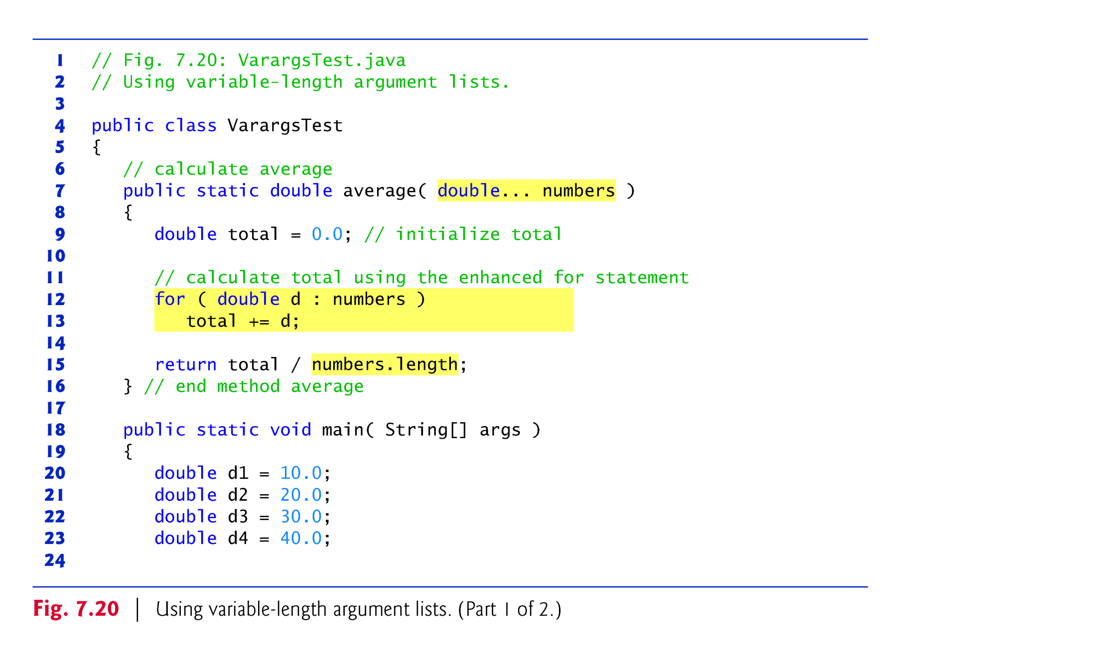

Slide 12
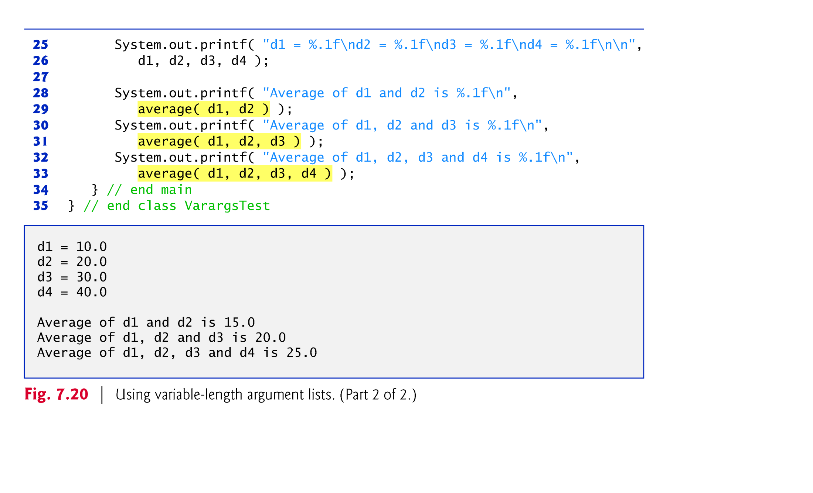

Slide 13
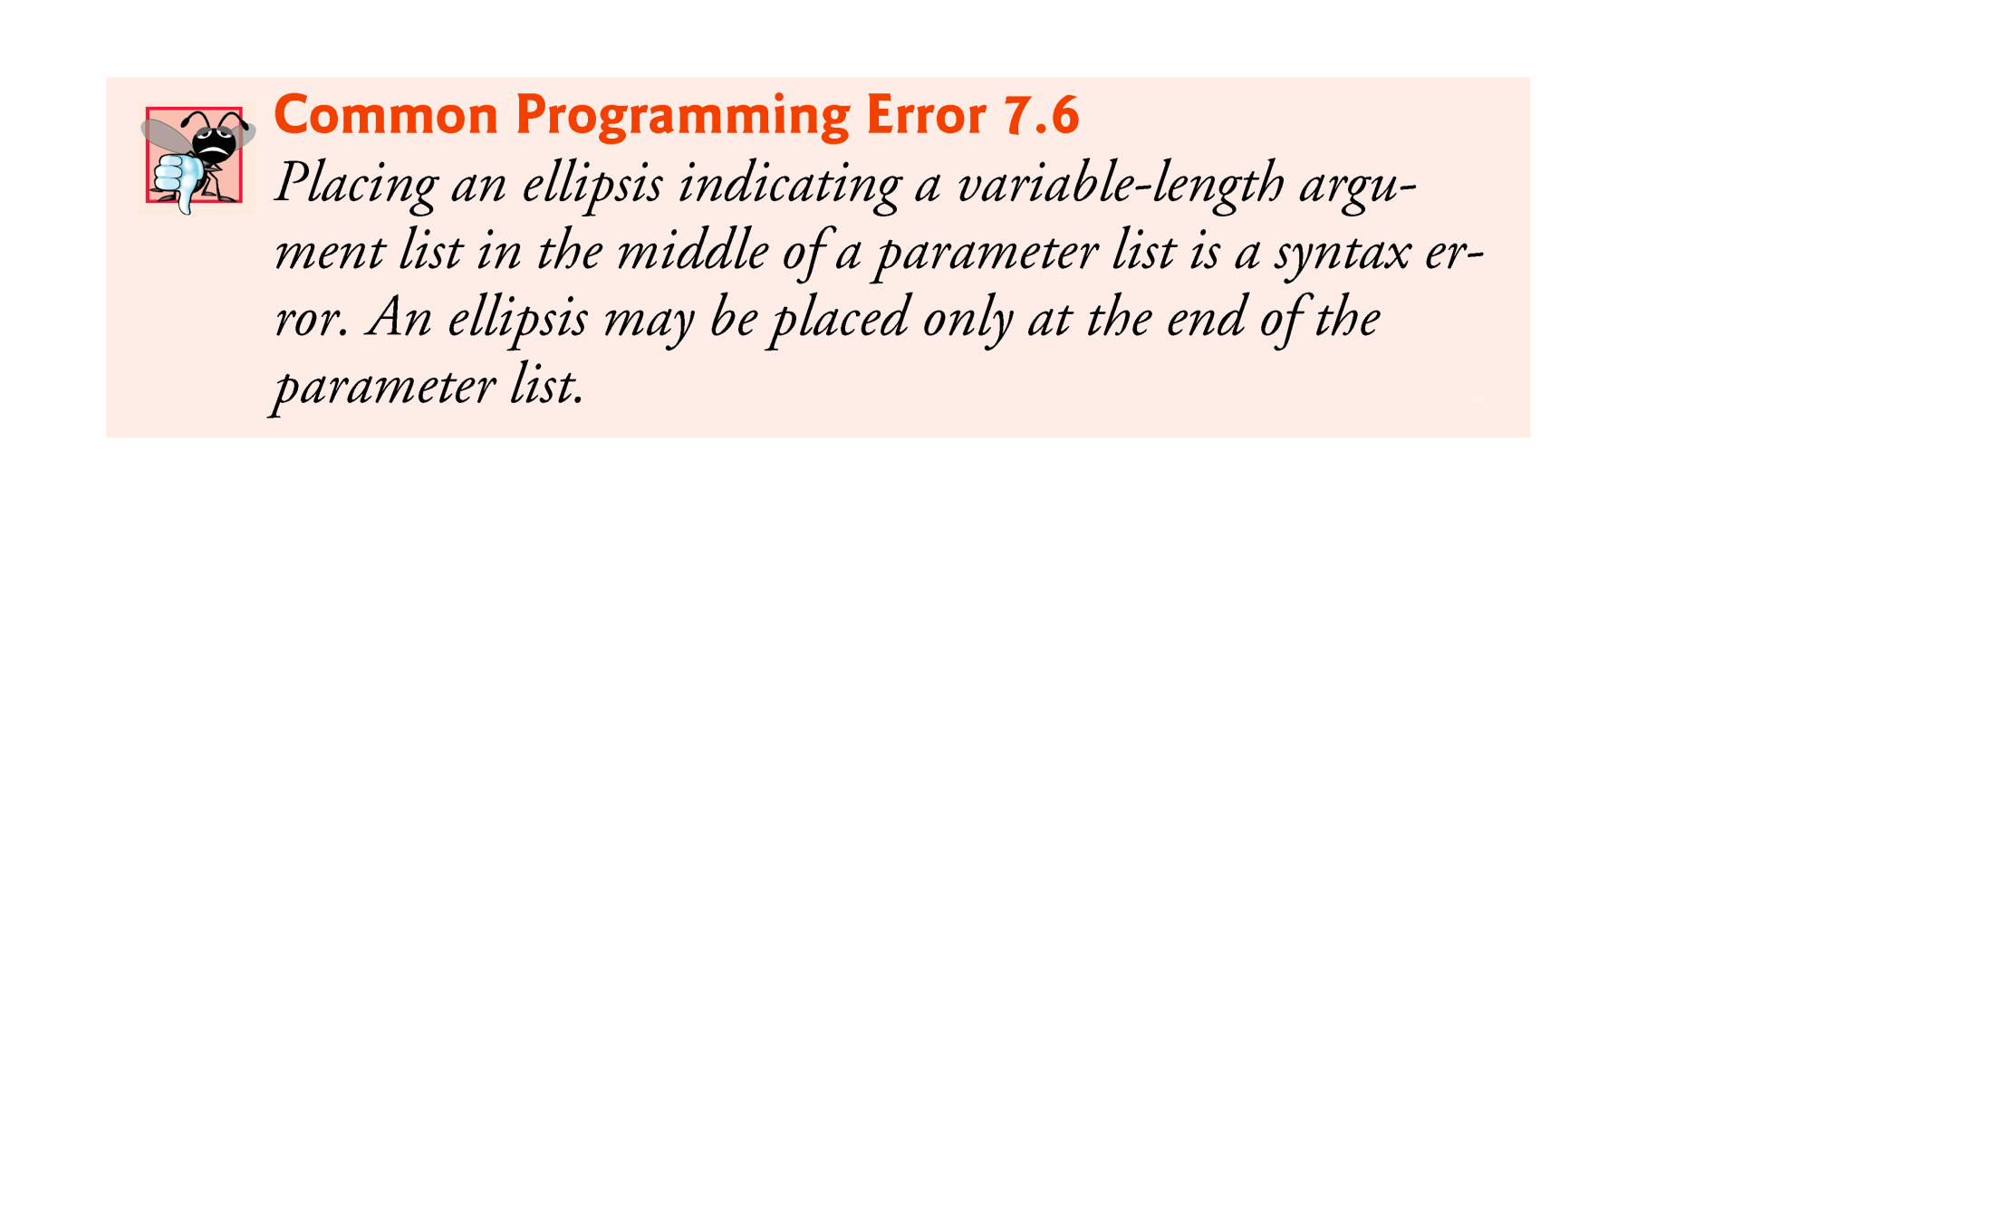
© Copyright 1992-2012 by Pearson Education, Inc. All Rights Reserved.

Slide 14

Command-line arguments
  Can pass arguments from the command line to an application.
  Arguments that appear after the class name in the java command are received by main in the String array args.
  The number of command-line arguments is obtained by accessing the array’s length attribute.
  Command-line arguments are separated by white space, not commas.
© Copyright 1992-2012 by Pearson Education, Inc. All Rights Reserved.

Slide 15
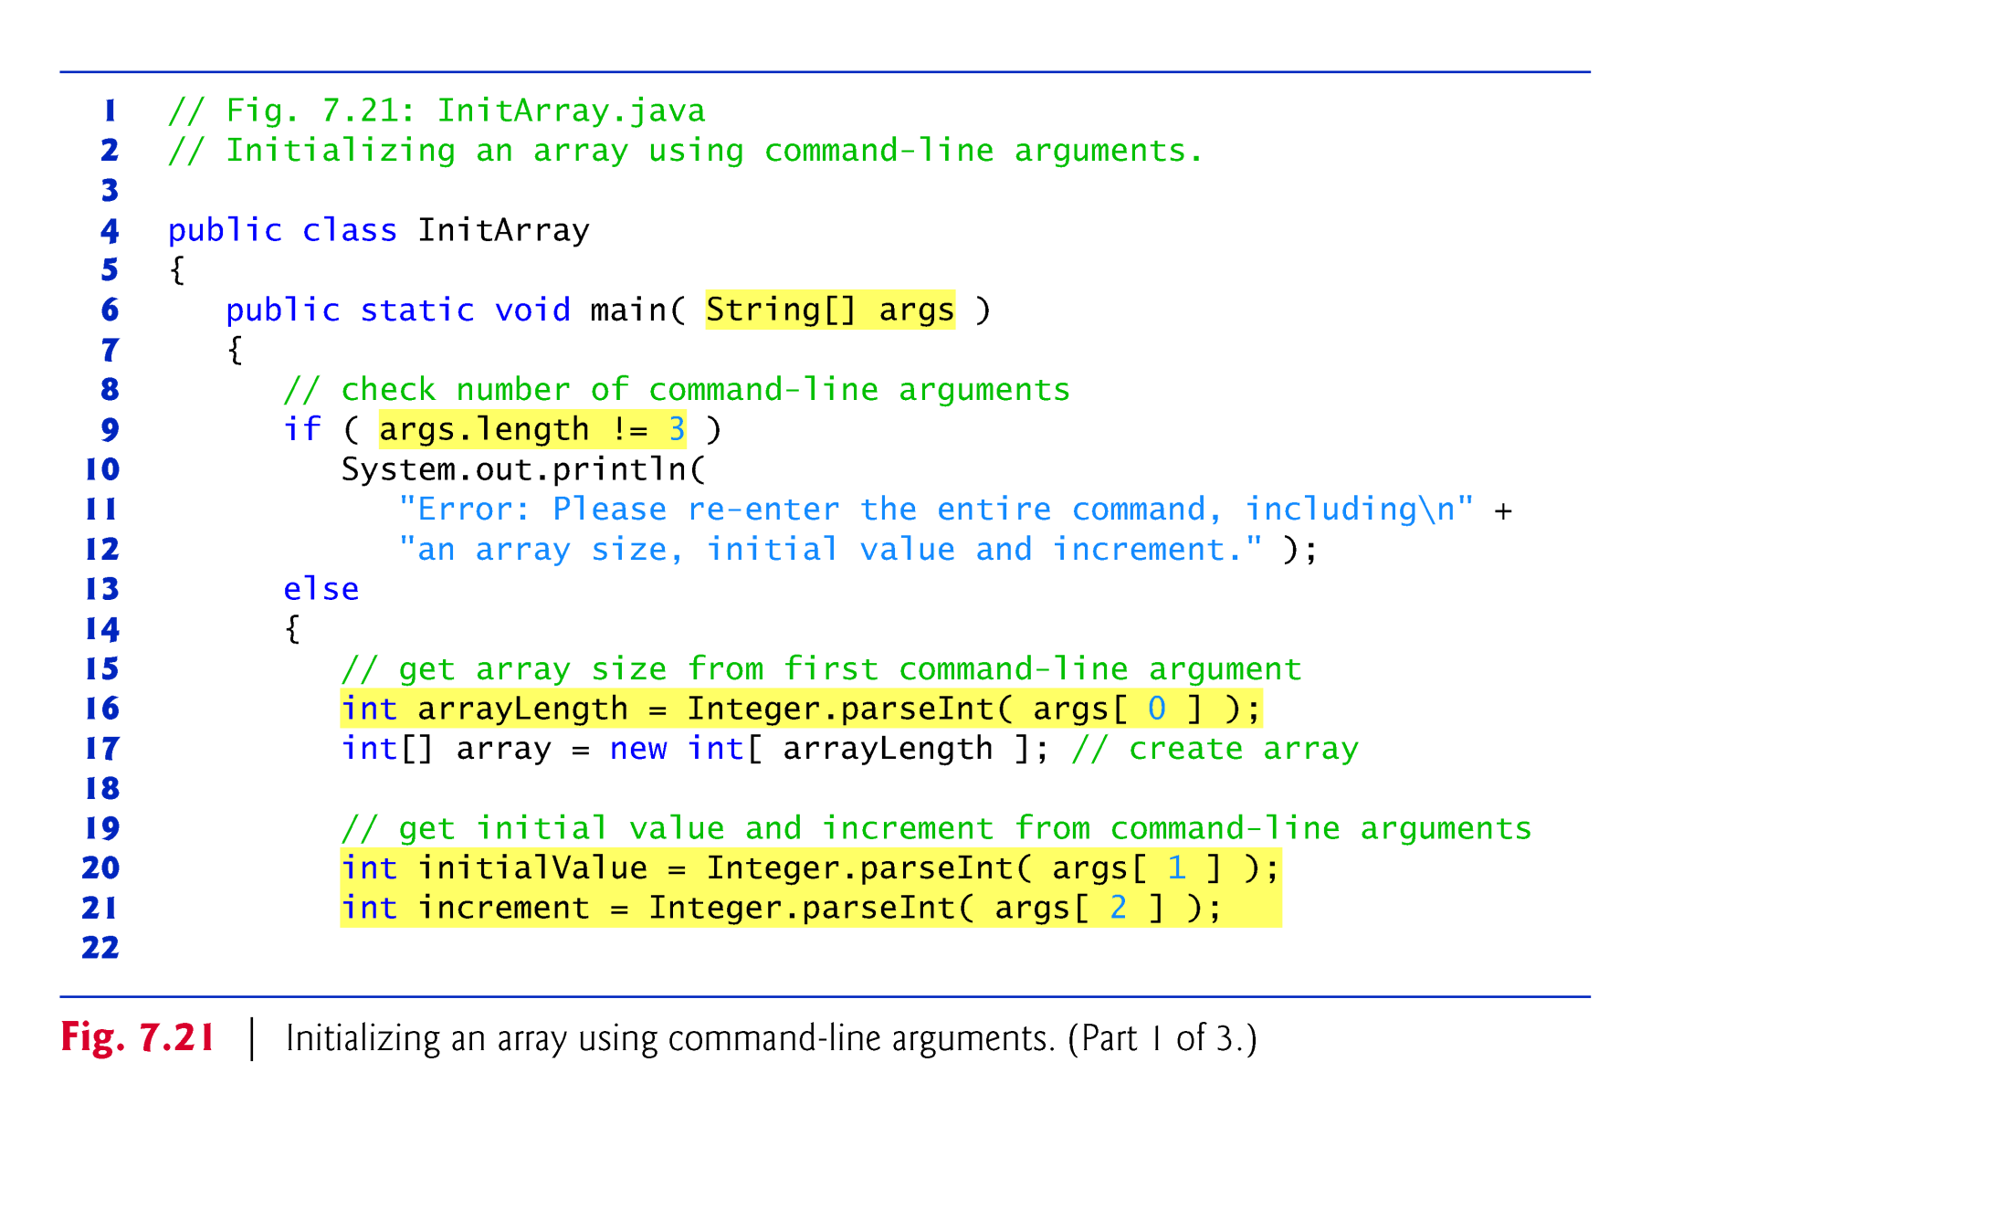

Slide 16
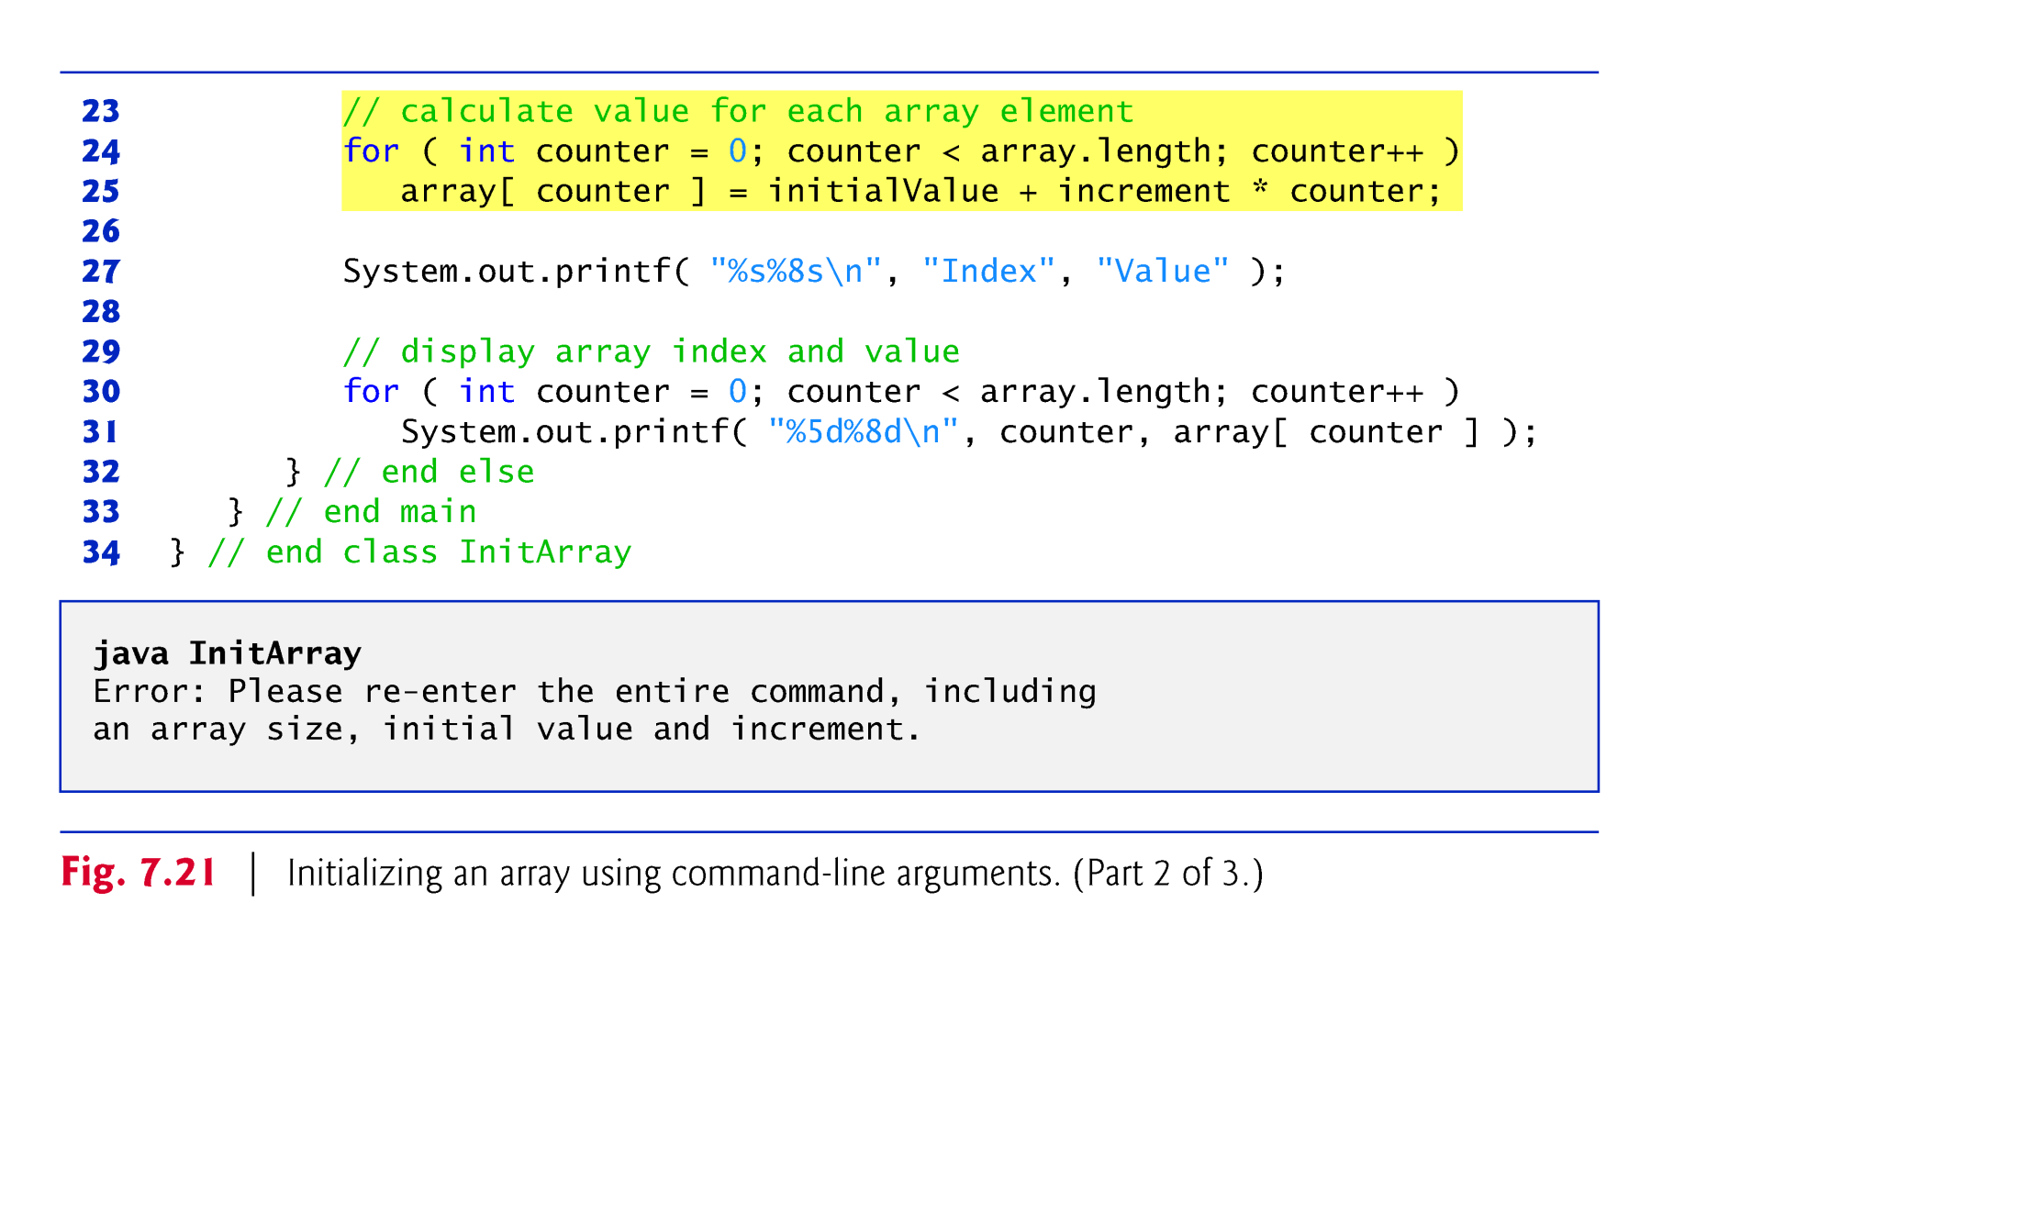

Slide 17
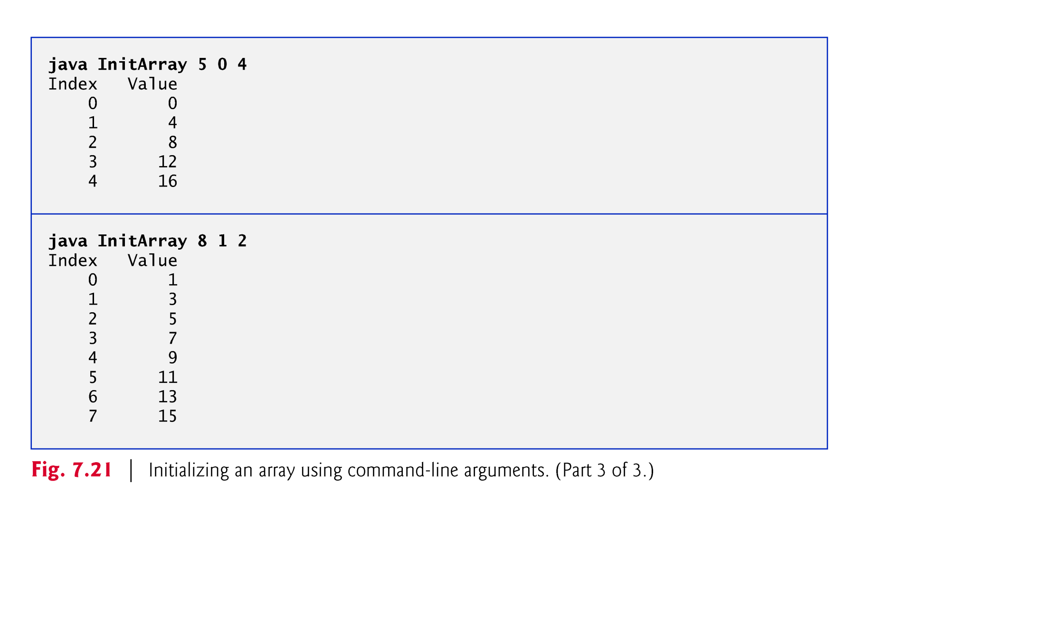

Slide 18

Arrays do not automatically change their size at execution time to accommodate additional elements.
ArrayList<T> (package java.util) can dynamically change its size to accommodate more elements.
  You have to import java.util.ArrayList before using ArrayList
  T is a placeholder for the type of element stored.
  This is similar to specifying the type when declaring an array, except that only non-primitive types can be used with these classes.
    We will shortly see what to do about primitive types
Classes with this kind of placeholder that can be used with any type are called generic classes.
© Copyright 1992-2012 by Pearson Education, Inc. All Rights Reserved.

Slide 19
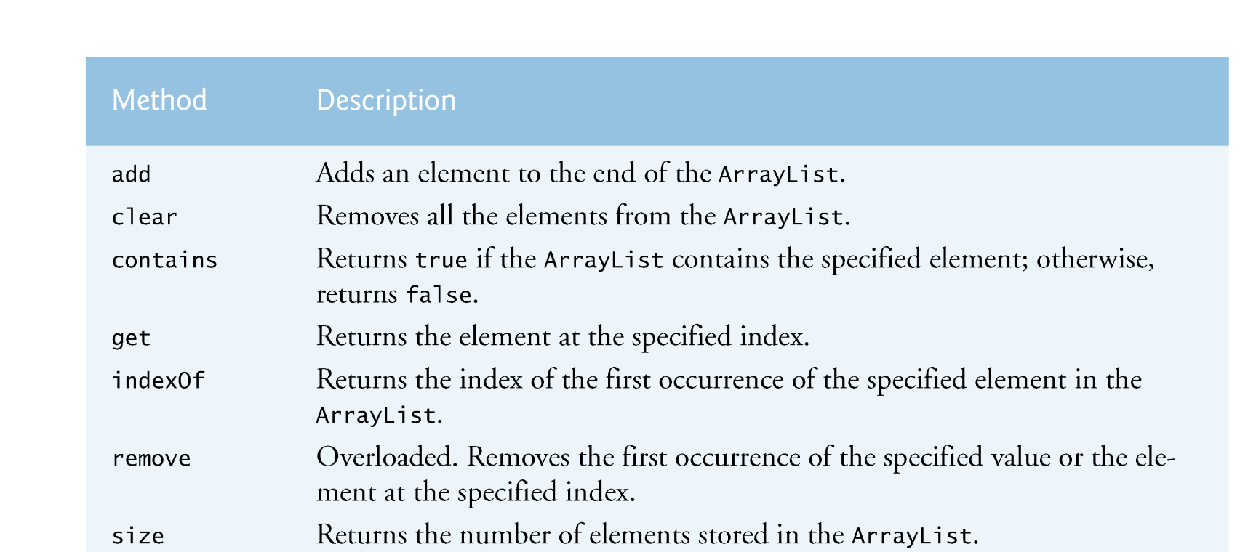
Methods of the ArrayList class

Slide 20

Figure 7.24 demonstrates some common ArrayList capabilities.
© Copyright 1992-2012 by Pearson Education, Inc. All Rights Reserved.

Slide 21
Method add adds elements to the ArrayList.
  One-argument version appends its argument to the end of the ArrayList.
  Two-argument version inserts a new element at the specified position.
  Collection indices start at zero.
Method size returns the number of elements in the ArrayList.
Method get obtains the element at a specified index.
Method remove deletes an element with a specific value.
  An overloaded version of the method removes the element at the specified index.
Method contains determines if an item is in the ArrayList.
© Copyright 1992-2012 by Pearson Education, Inc. All Rights Reserved.

Slide 22
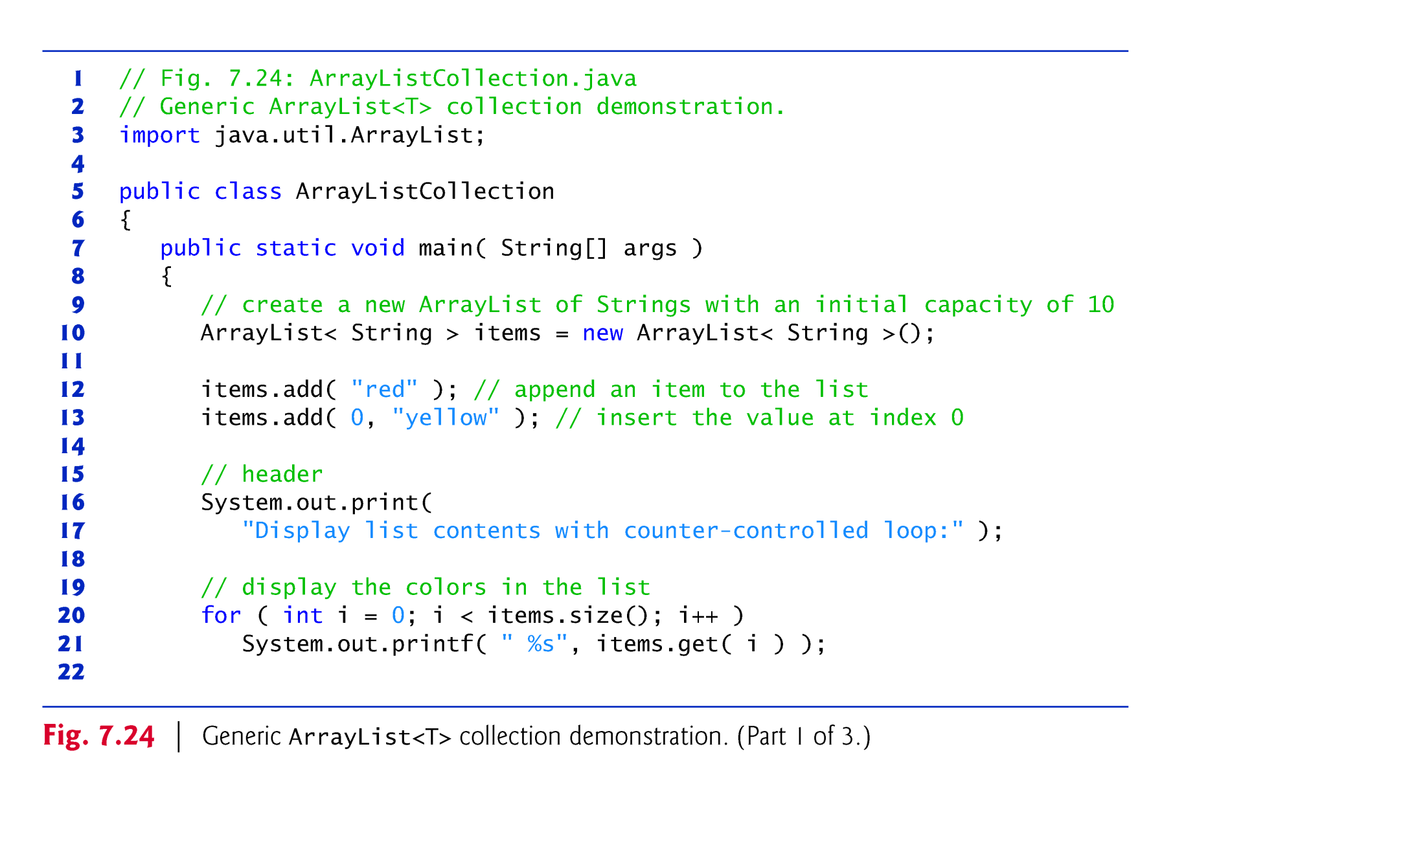

Slide 23
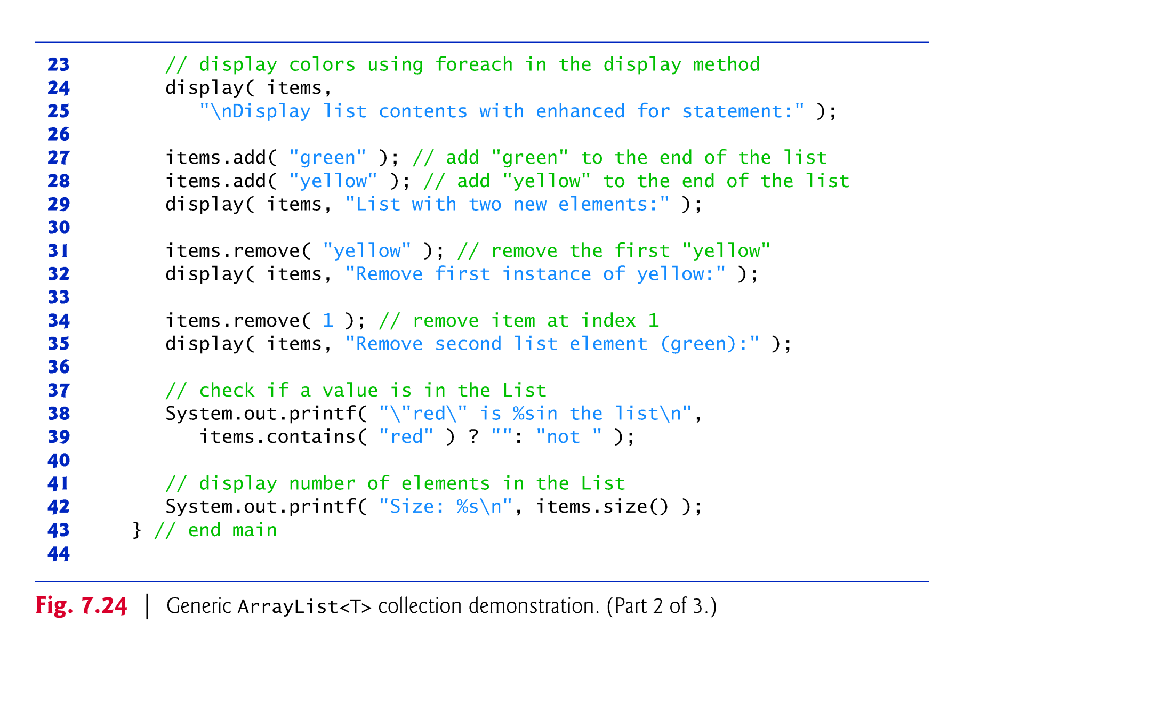

Slide 24
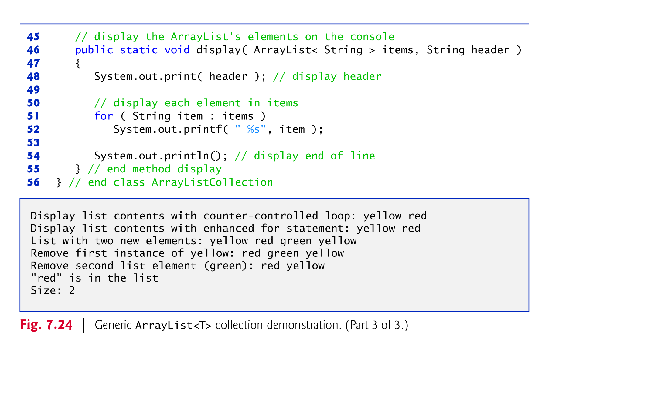

Slide 25
7.14 ArrayList (Contd.)
Method set modifies an element in the ArrayList.
  Two-arguments
    1. index (position) of element,
    2. new (modified) value of the element at specified index
© Copyright 1992-2012 by Pearson Education, Inc. All Rights Reserved.

Slide 26
public static void main(String[] args)
{
  ArrayList<String> items = new ArrayList<String>();
  items.add("yellow");
  items.add("red");
  display(items);
  items.add("blue");
  items.remove("red");
  display(items);
  items.set(0, "new");
  display(items);
}
OUTPUT
yellow
red
yellow
blue
new
blue
© Copyright 1992-2012 by Pearson Education, Inc. All Rights Reserved.

Slide 27
Wrapper classes
Primitive Types can not be used with an ArrayList, i.e. we cannot create an ArrayList of primitive types,
  e.g. ArrayList<int> arrayL;
Java provides a wrapper classes for this purpose.
Each of Java's eight primitive data types has a class dedicated to it, known as its wrapper class, e.g. Integer for int datatype.
  they "wrap" the primitive data type into an object of that class.
The wrapper classes are part of the java.lang package, which is imported by default into all Java programs.
© Copyright 1992-2012 by Pearson Education, Inc. All Rights Reserved.

Slide 28
primitive | Wrapper Class
boolean | Boolean
byte | Byte
char | Character
int | Integer
float | Float
double | Double
long | Long
short | Short
Wrapper classes (Contd.)
Table on right shows eight primitive types along with their wrapper classes
To create an integer variable and an object of Integer wrapper class:
int x = 25;
Integer y = new Integer(33);
To create an ArrayList of Integers:
Rest of the details of using ArrayList is the same as with String (or any other reference type), which we already discussed
ArrayList<Integer> intAL = new ArrayList<Integer>();
© Copyright 1992-2012 by Pearson Education, Inc. All Rights Reserved.

Slide 29
Conversion between primitive types and corresponding Wrapper classes
Java compiler automatically converts between primitive types and corresponding classes.
  Thus, the primitive types and their wrapper classes can be used interchangeably.
Converting a primitive value (an int, for example) into an object of the corresponding wrapper class (Integer) is called autoboxing.
Converting an object of a wrapper type (Integer) to its corresponding primitive (int) value is called unboxing.
Examples (Autoboxing and unboxing):
  https://docs.oracle.com/javase/tutorial/java/data/autoboxing.html#:~:text=Autoboxing%20is%20the%20automatic%20conversion,way%2C%20this%20is%20called%20unboxing.
© Copyright 1992-2012 by Pearson Education, Inc. All Rights Reserved.

Slide 30
import java.lang.Math; // header stuff MUST go above the first class
import java.util.Scanner;
import java.util.ArrayList;
// our main class becomes a file but the main method is still found
public class HelloWorld {
public static void main(String[] args) {
ArrayList<Integer> alIntegers = new ArrayList<Integer>();
int number;
Scanner sc = new Scanner(System.in);
alIntegers.add(23); // no error
alIntegers.add(new Integer(25));
Integer myInt = new Integer(100);
alIntegers.add(myInt);
System.out.println("printing using Integer class");
for(Integer i: alIntegers) {
System.out.println(i);
}
System.out.println("printing using int type");
for(int i: alIntegers) { // quite ok
System.out.println(i);
}
}
}
© Copyright 1992-2012 by Pearson Education, Inc. All Rights Reserved.

